Slide 1
Challenging the traditional machine learning workflow
Datasets for real-time machine learning
Dr. Rebecca Bilbro / Data Science DC / August 2023

Slide 2








Hi, I’m
Rebecca
🤓
I’ve been a data scientist 10 years!
rebeccabilbro
www.scikit-yb.org
Elder_Data_Scientist
Applied Text Analysis with Python
Founder and CTO of Rotational Labs

Slide 3

Or if the data is getting old (e.g. concept drift)?
Can we afford to have the MLOps team redo this whole thing?
Ingestion
Data Munging and Wrangling
We can’t start doing machine learning until we get enough data!
Computation
and Analysis
The database is live; how do we get back to the version of the data the old model was trained on?
What if the model is starting to be wrong a lot (model drift)?
It took us 6 months to realize we didn’t actually need ML, just a time series plot and a running average.
Visual Analysis
Modeling and Application

Slide 4

Where do batches come from?
Database table dumps
Materialized views
RESTful & GraphQL Data APIs
3rd party data assets (e.g. ftp)
Berkeley’s UCI ML repository
Academic papers
Misc “found” datasets
A snapshot, frozen in time
Notes:
Good for certain use cases: recommender systems, network graphs, entity reconciliation
Popular linear algebra models expect large batches of training data held in memory at once.
Many academic disciplines (e.g. epidemiology, economics, etc) share a common mental model.
Mainstream OSS tools are architected for batches (e.g. scikit-learn, Pytorch, TF).

Slide 5


Where do streams come from?
Database change data capture (CDC ) logs
Real-time data APIs
Live, running applications
IoT/ edge/ sensor devices
Customer behaviors
Social media interactions
Security and observability logs
And more…
A record of all changes over time

Slide 6
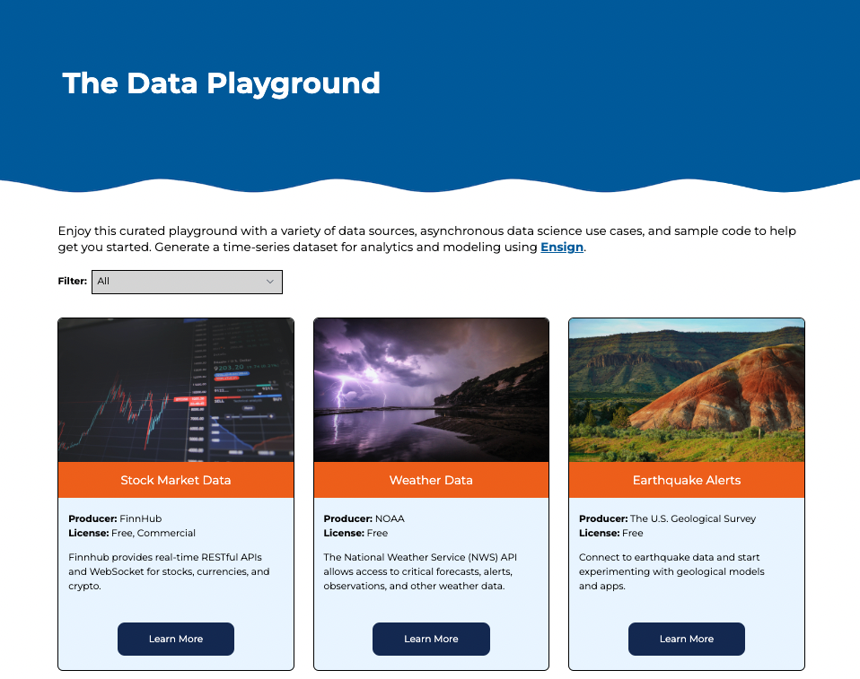
Visit the Playground
Check out more data sources you can start using now: stock market, weather, flights, etc.
https://rotational.io/data-playground

Slide 7
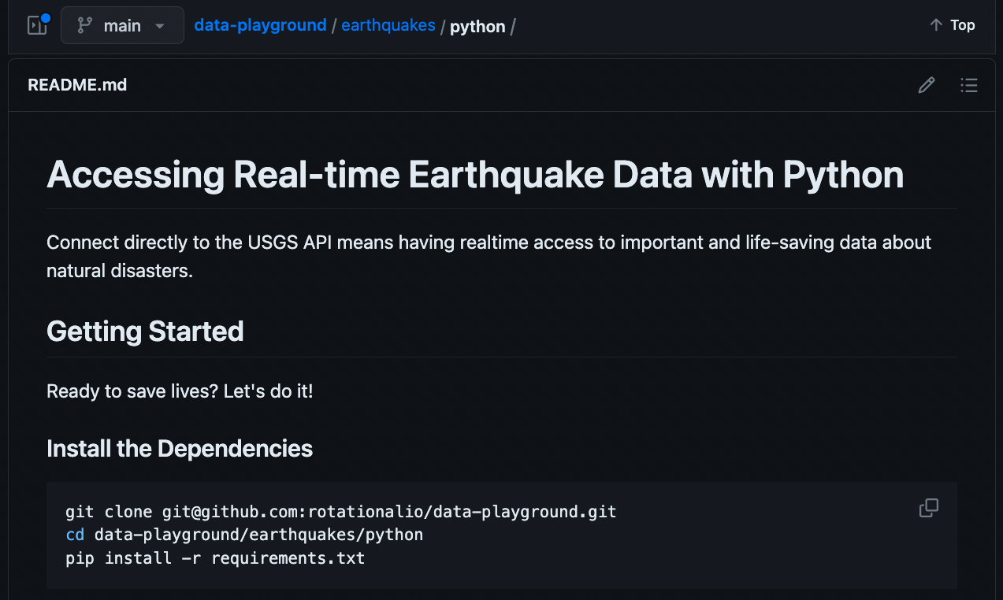
Navigate to the python example and clone it locally to your machine

Slide 8

class EarthquakePublisher:
def __init__(self, topic="earthquakes-json", interval=900, user=ME):
# details omitted for brevity
def compose_query(self):
# details omitted
def unpack_usgs_response(self, message):
geo_events = message.get("features", None)
# details omitted
for geo_event in geo_events:
details = geo_event.get("properties", None)
if details is None:
raise Exception("unable to parse usgs response, no event details found")
data = {...} # details omitted
yield Event(json.dumps(data).encode("utf-8"), mimetype=self.datatype)
async def recv_and_publish(self):
await self.ensign.ensure_topic_exists(self.topic)
while True:
query = self.compose_query()
response = requests.get(query).json()
events = self.unpack_usgs_response(response)
for event in events:
await self.ensign.publish(
self.topic,
event,
on_ack=self.print_ack,
on_nack=self.print_nack,
)
await asyncio.sleep(self.interval)
def run(self):
asyncio.run(self.recv_and_publish())
Publisher
client.publish

Slide 9

class EarthquakeSubscriber:
def __init__(self, topic="earthquakes-json"):
self.topic = topic
self.ensign = Ensign()
def run(self):
"""
Run the subscriber forever.
"""
asyncio.run(self.subscribe())
async def handle_event(self, event):
try:
data = json.loads(event.data)
except json.JSONDecodeError:
print("Received invalid JSON in event payload:", event.data)
await event.nack(nack.UnknownType)
return
print("New earthquake report received:", data)
await event.ack()
async def subscribe(self):
"""
Subscribe to the earthquake topic and parse the events.
"""
id = await self.ensign.topic_id(self.topic)
async for event in self.ensign.subscribe(id):
await self.handle_event(event)
Subscriber
client.subscribe

Slide 10
class EarthquakeSubscriber:
def __init__(self, topic="earthquakes-json", threshold=4.2):
self.topic = topic
self.ensign = Ensign()
self.threshold = threshold
async def handle_event(self, event):
emergency = false
try:
data = json.loads(event.data)
emergency = self.detect_emergencies(data)
except json.JSONDecodeError:
print("Received invalid JSON in event payload:", event.data)
await event.nack(nack.UnknownType)
return
if emergency:
print("Severe disturbance detected, engage emergency measures:", data)
else:
print("Low-magnitude earthquake detected:", data)
await event.ack()
def detect_emergencies(self, geo_event):
magnitude = geo_event.get("magnitude", None)
if magnitude is not None and magnitude >= self.threshold:
return true
else:
return false
You can embed real-time analytics into a Subscriber to interpret events without delay.

Slide 11
class EarthquakeSubscriber:
def __init__(self, topic="earthquakes-json", threshold=4.2):
self.topic = topic
self.ensign = Ensign()
self.threshold = threshold
async def handle_event(self, event):
emergency = false
try:
data = json.loads(event.data)
emergency = self.detect_emergencies(data)
except json.JSONDecodeError:
print("Received invalid JSON in event payload:", event.data)
await event.nack(nack.UnknownType)
return
if emergency:
print("Severe disturbance detected, engage emergency measures:", data)
else:
print("Low-magnitude earthquake detected:", data)
await event.ack()
def model_emergencies(self, geo_event):
magnitude = geo_event.get("magnitude", None)
if magnitude is not None:
self.update_model(geo_event)
print("Predictive model has been updated!")
You can use the same trick to do real-time modeling and inference, triggering a model update or prediction immediately.

Slide 12
Thank you!
Check out the Data Playground for more real-time data science inspiration!

